Slide 1

Setting Up the Development Environment
[PHONG HA]

Slide 2
Tools
Frontend
VSCode
Angular CLI
NPM
Backend
Eclipse/SpringToolSuite
MVN
OpenJDK 16

Slide 3
Library
Lombok
Mapstruct

Slide 4
Lombok
A library that generates Java code based on annotations. It keeps the code samples concise, reducing the boilerplate so the reader can focus on what it matters.
Homepage: https://projectlombok.org/

Slide 5
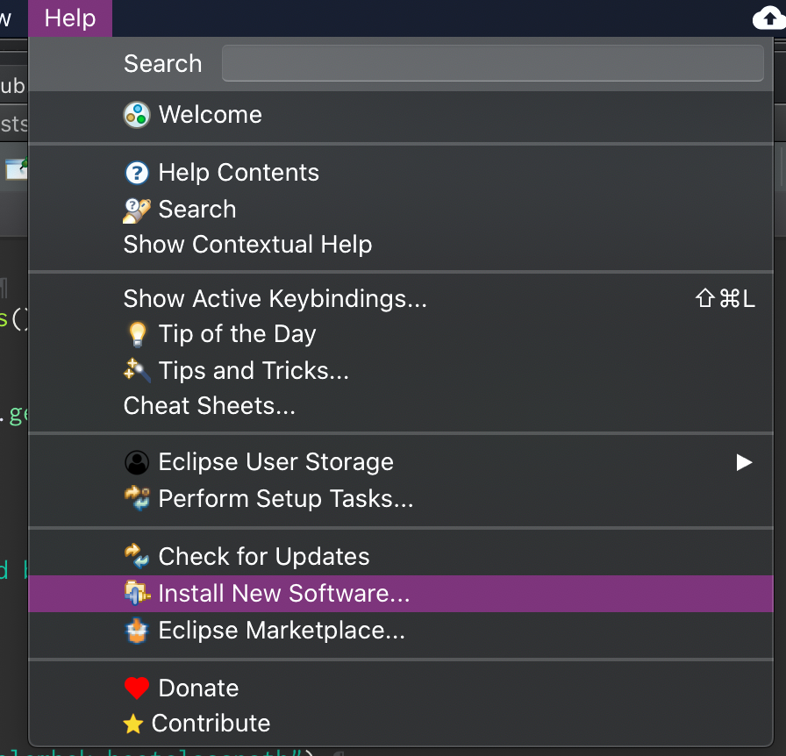
Install Lombok
Install via eclipse plugin installer: Help/Install New Software…

Slide 6
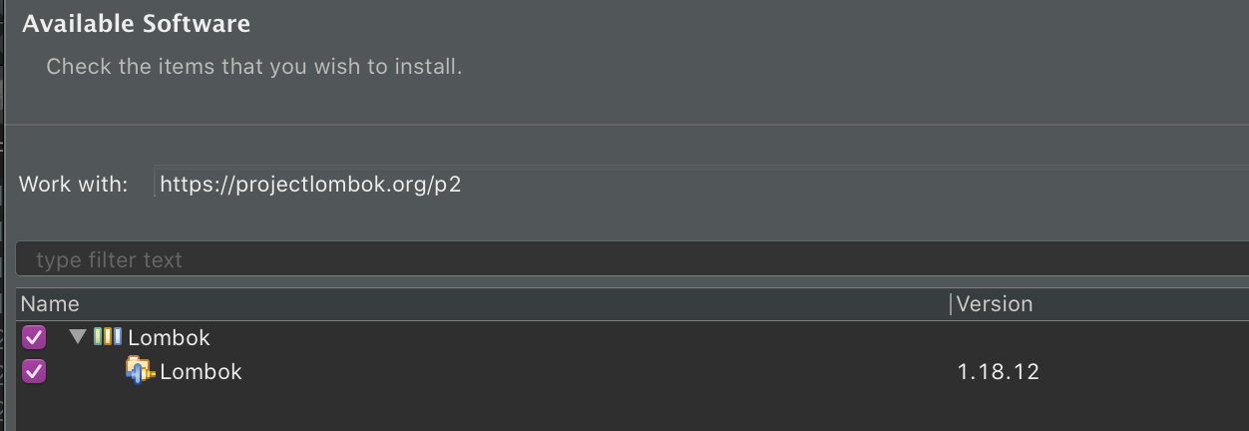
Install Lombok
Use update site https://projectlombok.org/p2

Slide 7
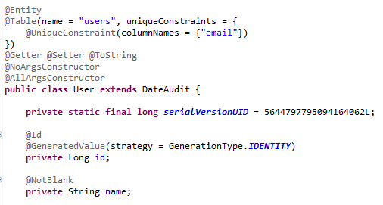
Use Lombok
By adding the @Getter, @Setter, @ToString annotations we told Lombok to, well, generate these for all the fields of the class.
@NoArgsConstructor will generate a constructor with no parameters.
@AllArgsConstructor generates a constructor with 1 parameter for each field in your class.

Slide 8
Mapstruct
MapStruct is a code generator that greatly simplifies the implementation of mappings between Java bean types based on a convention over configuration approach.
The generated mapping code uses plain method invocations and thus is fast, type-safe and easy to understand.
Homepage: https://mapstruct.org/

Slide 9
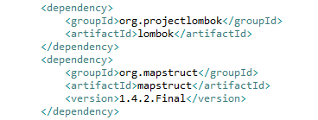
Mapstruct Initial Maven Dependencies
You should have the following dependencies in your Maven POM.

Slide 10
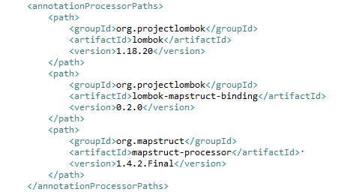
MapStruct Annotation Processing Configuration
You need to add the following to the build / plugins section of the POM.

Slide 11

MapStruct Spring Configuration
A nice feature of MapStruct is the ability to optionally annotate the mappers with the Spring @Component stereotype. With this option enabled, the generated mappers will be available for dependency injection as Spring Beans
This is also shown in the Maven Compiler configuration above.

Slide 12

Use MapStruct
Update EmployeeDetails from EmployeeDetailsDTO
Create interface with method “updateEmployeeFromDto”. we did not create an implementation class for our EmployeeMapper — because MapStruct creates it for us.

Slide 13
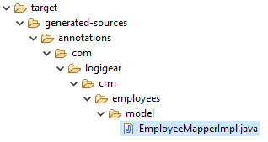
The New Mapper
Run “mvn package”. This will generate the implementation class under /target/generated-sources/annotations/.

Slide 14
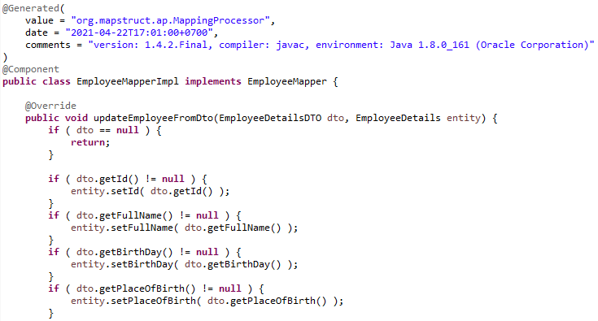
The New Mapper
Here is the class that MapStruct auto-creates for us:

Slide 15

Thank You!

